Slide 1
IP Address
Computer Networks
1

Slide 2
IP Address
An IP address is an address used in order to uniquely identify a
device on an IP network
IP Addresses are used to route packets from a sending node to a receiving node
The address is made up of 32 binary bits
Divided into a network portion and host portion with the help of a subnet mask
The Internet Assigned Numbers Authority (IANA) assigns network identifiers to avoid duplications

Slide 3
IP Address
The 32 binary bits are broken into four octets (1 octet = 8 bits)
Each octet is converted to decimal and separated by a dot
For this reason, an IP address is said to be expressed in dotted decimal format (for example, 172.16.81.100)
The value in each octet ranges from 0 to 255 decimal, or
00000000 − 11111111 binary

Slide 4
Dotted Decimal Notation
IP addresses are written in a dotted decimal notation
Each byte is identified by a decimal number in the range [0..255]:
Example:
10000000 | 10001111 | 10001001 | 10010000
1st Byte
= 128
2nd Byte
= 143
3rd Byte
= 137
4th Byte
= 144
128.143.137.144

Slide 5

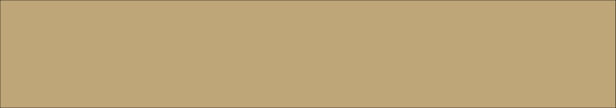


Network prefix and Host number
The network prefix identifies a network and the host number identifies a specific host
Network Prefix
host number

Slide 6

What is an IP Address?
An IP address is a 32-bit address
The IP addresses are
unique

Slide 7
Address Space Rule
The address space in a protocol that uses
N-bits to define an Address is:
₂N

Slide 8
IPv4 Address Space
The address space of IPv4 is
₂32
or 4,294,967,296

Slide 9
Binary Notation
01110101 10010101 00011101 11101010

Slide 10
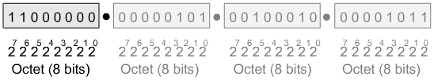
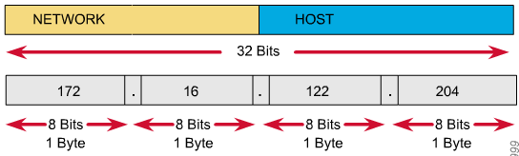
IP Address as a 32-Bit Binary Number

Slide 11
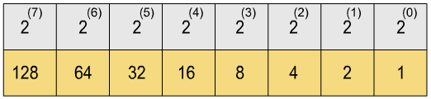
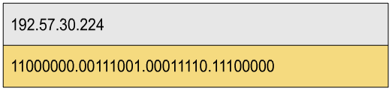
Binary and Decimal Conversion

Slide 12
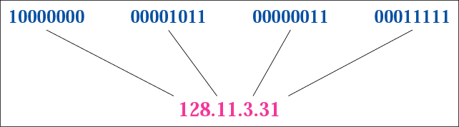
Dotted-Decimal Notation

Slide 13
Example 1
Change the following IP address from binary notation to dotted- decimal notation.
10000001 00001011 00001011 11101111
Solution
129.11.11.239

Slide 14
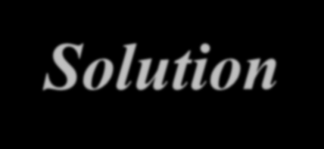
Example 2
Change the following IP address from dotted-decimal notation to binary notation:
111.56.45.78
Solution
01101111 00111000 00101101 01001110

Slide 15

Example 3
Find the error in the following IP Address
111.56.045.78
Solution
There are no leading zeroes in Dotted-decimal notation (045)

Slide 16

Example 4
Find the error in the following IP Address
75.45.301.14
Solution
In decimal notation each number <= 255
301 is out of the range

Slide 17
IP Address Classes
The IP is divided into different class with respect to their 1st octet

Slide 18
IP Address Classes
Class A
N.H.H.H
1-126
0 can not be used as Net ID
127 is reserved for loop back functions
126 Different Networks
16,777,214 Hosts per Network
Class A IP address range includes
1.0.0.0 to 126.255.255.255

Slide 19
IP Address Classes
Class B
N.N.H.H
128-191
The first IP Address is the NET ID
The last IP Address is the Broadcast Address
16,384 Different Networks
65534 Hosts per Network
Class B IP address range includes
128.0.0.0 to 191.255.255.255

Slide 20
IP Address Classes
Class C
N.N.N.H
192-223
The first IP Address is the NET ID
The last IP Address is the Broadcast Address
2,097,152 Different Networks
254 Hosts per Network
Class C IP address range includes
192.0.0.0 to 223.255.255.255

Slide 21
IP Address Classes
CLASS D – Used for multicast broadcasts
Class D address can be used to represent a group of hosts called a host group, or multicast group
Class D IP address range includes
224.0.0.0 to 239.255.255.255
CLASS E – Experimental (Research) addresses not available to the public
Class E IP address range includes
240.0.0.0 to 255.255.255.255

Slide 22

IP Address Classes (Binary)
Class A Address
The first bit of the first octet is always set to 0 (zero). Thus the first octet ranges from 1 – 127
Class A addressing can have 126 networks (2⁷-2) and 16777214 hosts (2²⁴-2).
Class A IP address format is thus:
0NNNNNNN.HHHHHHHH.HHHHHHHH.HHHHHHHH

Slide 23

IP Address Classes (Binary)
Class B Address
An IP address which belongs to class B has the first two bits in the first octet set to 10
Class B has 16384 (2¹⁴) Network addresses and 65534 (2¹⁶-2) Host addresses.
Class B IP address format is:
10NNNNNN.NNNNNNNN.HHHHHHHH.HHHHHHHH

Slide 24

IP Address Classes (Binary)
Class C Address
The first octet of Class C IP address has its first 3 bits set to 110
Class C gives 2097152 (2²¹) Network addresses and 254 (2⁸-2) Host addresses.
Class C IP address format is:
110NNNNN.NNNNNNNN.NNNNNNNN.HHHHHHHH

Slide 25
Example 5
Find the class of the following addresses
158.223.1.108
227.13.14.88
Solution
158.223.1.108
1st byte = 158 (128<158<191) class B 227.13.14.88
1st byte = 227 (224<227<239) class D

Slide 26
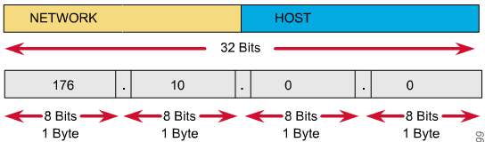
Network IDs and Broadcast Addresses
An IP address such as 176.10.0.0 that has all binary 0s in the host bit positions is reserved for the network address.
An IP address such as 176.10.255.255 that has all binary 1s in the host bit positions is reserved for the broadcast address.

Slide 27
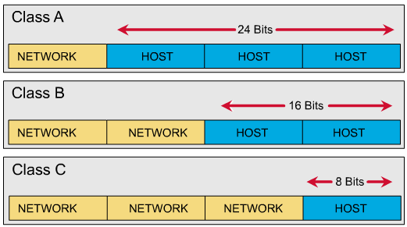
Hosts for Classes of IP Addresses
Class A (24 bits for hosts) 2²⁴ - 2* = 16,777,214 maximum hosts Class B (16 bits for hosts) 2¹⁶ - 2* = 65,534 maximum hosts Class C (8 bits for hosts) 2⁸ - 2* = 254 maximum hosts
* Subtracting the network and broadcast reserved address

Slide 28
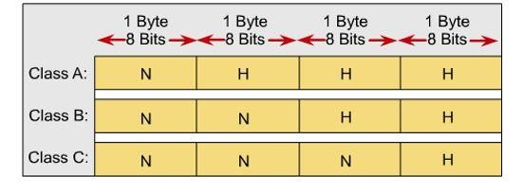
IP Address Classes

Slide 29
Network Masks (Default Mask)
A network mask helps to know which portion of the address identifies – the network and which portion of the address identifies the host
A mask is a 32-bit binary number
Class A, B, and C networks have default masks, also known as natural masks.
Class A default mask is 255.0.0.0 Class B default mask is 255.255.0.0 Class C default mask is 255.255.255.0

Slide 30
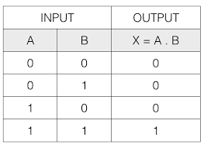

Find Network ID
Find Network ID from an IP address with the help of subnet mask.
Logical AND operation between IP and
subnet mask

Slide 31
Example 7
Given the network address 132.21.0.0, find the class, the NETID, and the range of the addresses
Solution
The 1st byte is between 128 and 191. Hence, Class B The block has a NETID of 132.21.0.0
The addresses range from
132.21.0.0 to 132.21.255.255

Slide 32
Example 8
How the mask identify the network and host address Consider IP: 8.20.15.1 Default mask:255.0.0.0
Convert the address and mask to binary numbers
8.20.15.1 = 00001000.00010100.00001111.00000001
255.0.0.0 =11111111.00000000.00000000.00000000
AND
Solution
00001000.00000000.00000000.00000000
netid = 8.0.0.0

Slide 33
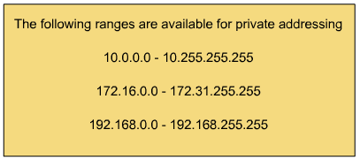
Private Addresses

Slide 34
Subnetting
To create multiple logical networks that exist within a single Class A, B, or C network
If you do not subnet, you are only able to use one network from your Class A, B, or C network.
The subnet mask is 32 bit value that usually expressed in dotted decimal notation

Slide 35
Subnet
Subnets are a subset of the entire network
Networks can be divided into subnets
Each subnet is treated as a separate network
A subnet can be a WAN or LAN

Slide 36
Subnets
Subnet 1
Subnet 2
Subnet 3
Subnet 4

Slide 37
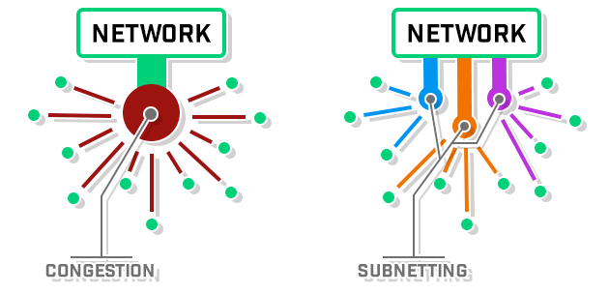
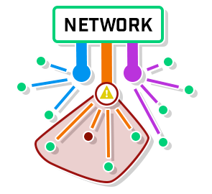
Why Sub-netting
Isolating Security Threats
Efficiency for Management

Slide 38
Subnet Mask
The subnet mask follows two rules:
If a binary bit is set to a 1 (or on) in a subnet mask, the corresponding bit in the address identifies the network
If a binary bit is set to a 0 (or off) in a subnet mask, the corresponding bit
in the address identifies the host

Slide 39
Example 9
Looking at the address and subnet mask in binary:
IP Address: 10011110.01010000.10100100.00000011
Subnet Mask: 11111111.11111111.00000000.00000000
The first 16 bits of the subnet mask are set to 1. Thus, the first 16 bits of the address identify the network
The last 16 bits of the subnet mask are set to 0. Thus, identify the
unique host on that network

Slide 40
Note
The network portion of the subnet mask must be attached
For example, a subnet mask of 255.0.0.255 is not valid
Subnetting is done by borrowing bits from the host part and add them the network part

Slide 41
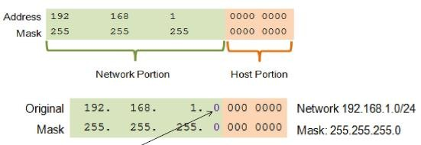
Basic Subnetting
Borrowing Bits to Create Subnets
Borrowing 1 bit 2¹ = 2 subnets
Subnet 0
– Network 192.168.1.0-127/25
– Mask: 255.255.255.128
Subnet 1
– Network 192.168.1.128-255/25
– Mask: 255.255.255.128

Slide 42
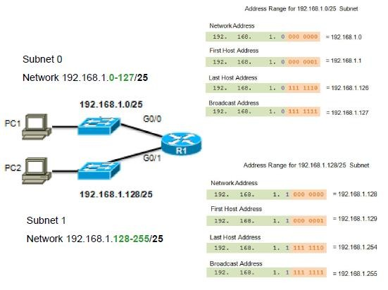
Subnets in Use

Slide 43
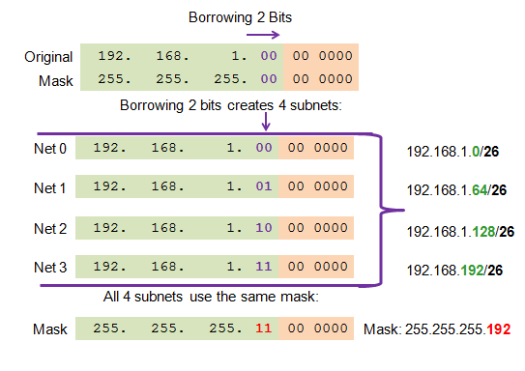
Creating 4 Subnets
Borrowing 2 bits to create 4 subnets. 2² = 4 subnets

Slide 44
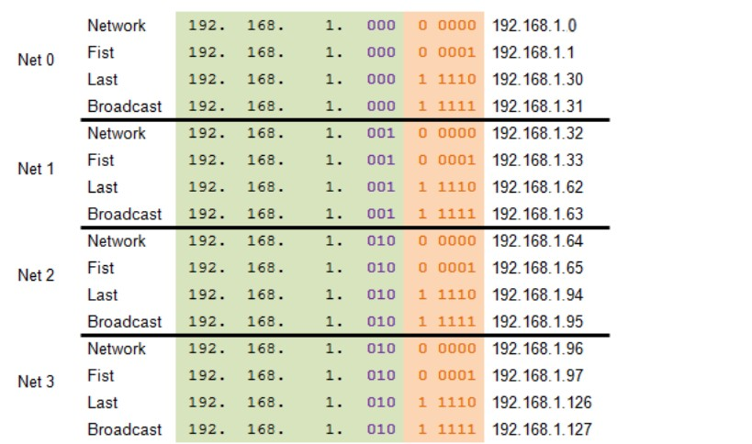
Creating 8 Subnets
Borrowing 3 bits to Create 8 Subnets. 2³ = 8 subnets

Slide 45
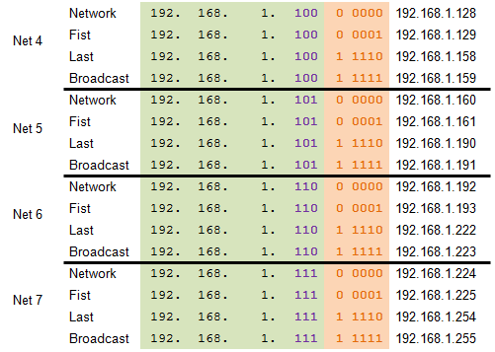
Creating 8 Subnets
Borrowing 3 bits to Create 8 Subnets. 2³ = 8 subnets

Slide 46
Finding the Subnet Address
Given an IP address, we can find the subnet address the same way we found the network address
We apply the mask to the address
We can do this in two ways: straight or short-cut

Slide 47
Finding the Subnet Address
Straight Method
In the straight method, we use binary notation for both the address and the mask and then apply the AND operation to find the subnet address

Slide 48
Example 10
What is the subnetwork address if the destination address is 200.45.34.56 and the subnet mask is 255.255.240.0?
Solution

Slide 49
Finding the Subnet Address
Short-Cut Method
If the byte in the mask is 255, copy the byte in the address
If the byte in the mask is 0, replace the byte in the address with 0
If the byte in the mask is neither 255 nor 0, we write the mask and the address in binary and apply the AND operation

Slide 50
Example 11
What is the subnetwork address if the destination address is
19.30.80.5 and the mask is 255.255.192.0?
Solution

Slide 51
Example 11

Slide 52

The number of subnets must be a power of 2

Slide 53
Example 12
A company is granted the site address 201.70.64.0 (class C). The company needs six subnets. Design the subnets
Solution
The number of 1s in the default mask is 24 (class C)

Slide 54
Example 12
Solution (Continued)
The company needs six subnets
This number 6 is not a power of 2. The next number that is a
power of 2 is 8 (2³)
We need 3 more 1s in the subnet mask
The total number of 1s in the subnet mask is 27 (24 + 3).
The total number of 0s is 5 (32 - 27)

Slide 55
Example 12
Solution (Continued)
The mask is
11111111 11111111 11111111 11100000
or
255.255.255.224
The number of subnets is 8
The number of addresses in each subnet is 2⁵ (5 is the number of 0s) or 32

Slide 56
Example 12 (Total Number of Subnets)
Subnet 1:
The bit combination is 001.
Taking last octet in binary :0 0 1 0 0 0 0 0 = 32 Hence the subnet address is, 201.70.64. 32 Subnet 2:
The bit combination is 01 0.
Taking last octet in binary :0 0 1 0 0 0 0 0 = 64
Hence the subnet address is, 201.70.64. 64

Slide 57
Example 12 (Total Number of Subnets)
Subnet 3:
The bit combination is 011.
Taking last octet in binary :0 1 1 0 0 0 0 0 = 96 Hence the subnet address is, 201.70.64. 96
Subnet 4:
The bit combination is 100.
Taking last octet in binary :1 0 0 0 0 0 0 0 = 128 Hence the subnet address is, 201.70.64. 128

Slide 58
Example 12 (Total Number of Subnets)
Subnet 5:
The bit combination is 101.
Taking last octet in binary :1 0 1 0 0 0 0 0 = 160 Hence the subnet address is, 201.70.64. 160 Subnet 6:
The bit combination is 110.
Taking last octet in binary :1 1 0 0 0 0 0 0 = 192
Hence the subnet address is, 201.70.64. 192

